Slide 1
Horse Bones vs Human Bones
Whispering Oak Stables

Slide 4
Horse Hindleg Bones

Slide 5
From Bottom to top of Horse hindleg:
27-Distal Phalanx (coffin bone)
26-Middle Phalanx (Short Pastern) P1
25-Proximal Phalanx (Long Pastern) P2
24-Sesamoid Bone
23-Matatarsel (Hind Cannon)
18-Splint bone
22-Tarsel bone
7-Point of Hock (Our heel)
21-Tibia
20-Femur
Numbers 27 through 25 are the same bones as a human’s toe
Numbers 23 is the long bone in a human foot
Number 7 is the same as a human heel

Slide 6
Forelimbs

Slide 8
Horse Leg bones upside down to give better comparison.
26-Distal Phalange
25-Middle Phalange
24-Proximal Phalange
23-Sesamoids
22-Metacarpus (Cannon bone)
14-Splint Bone
27-Carpel Bones
(Knee Joint)
16-Accessory carpal bone (pisiform)
21-Radius
20-Olecranon (Point of Elbow)
19-Humerus

Slide 9
Homologous Structures- Same structures, different purpose

Slide 11
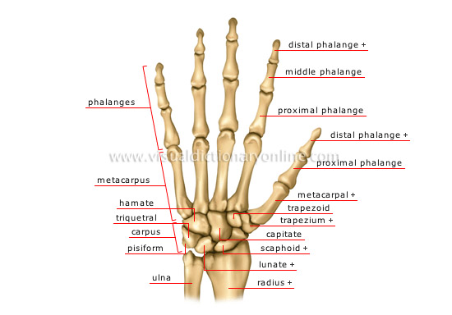
Human Hand Bones

